Slide 1
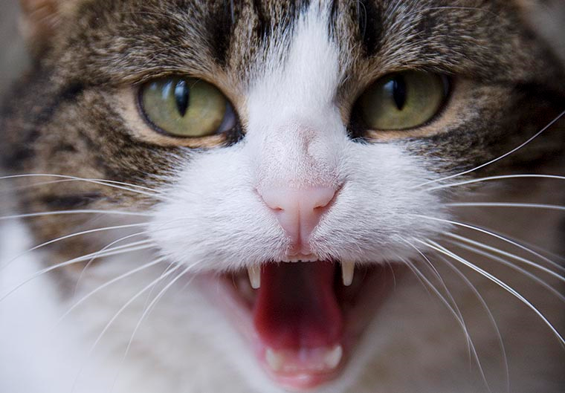
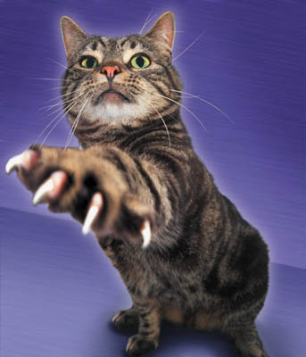
CH 3 - Part 2

Slide 2
Parenteral vs. Non-Parenteral Administration Routes
Parenteral Administration
Non-Parenteral Routes
Literally means “administered in the space between the enteric canal (the GI tract) and the surface of the body”
Further divided into specific routes:
  IV, IM, SC, ID, IA, IP, etc.
Drugs given by mouth = Oral administration (PO)
Applied to the surface of the skin = Topical administration
Inhalation or aerosol administration usually means the drug is administered as a mist or gas via the respiratory tract.

Slide 3
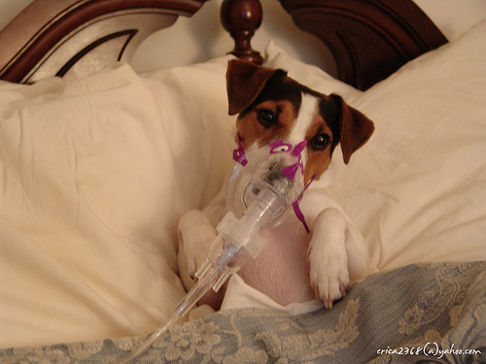
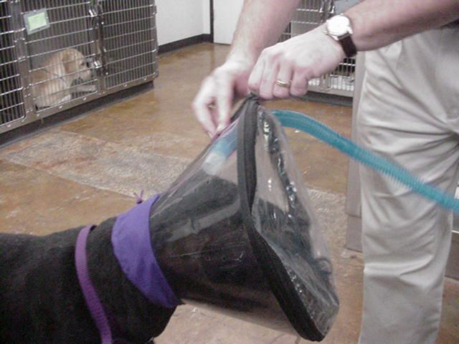
Method of administration:
INHALATION

Slide 4
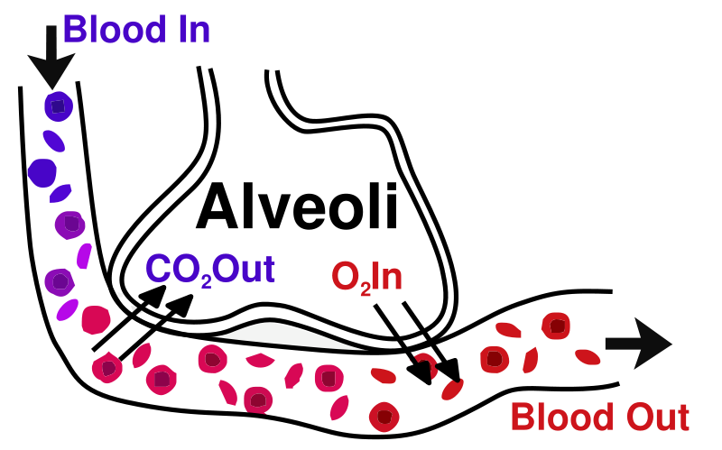
Inhalation Administration
Drugs are administered in the form of a gas or spray and are rapidly absorbed into the bloodstream.
An animal breathes in the drug which travels to the lungs and then further into the alveoli where the particles diffuse into the
bloodstream and are
distributed throughout
the body.

Slide 5
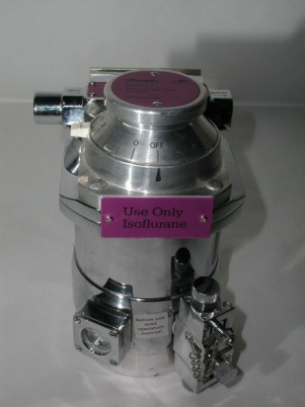
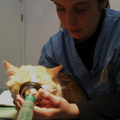
When are inhaled drugs used?
Gas Anesthesia
  Drugs are volatilized (turned into gases) from liquids using a vaporizer
Treat respiratory conditions
  Bronchodilators, mucolytic enzymes, antibiotics, steroids
    Drugs are nebulized (turned into a fine spray)

Slide 6
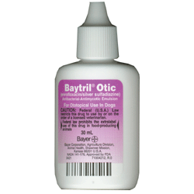
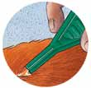
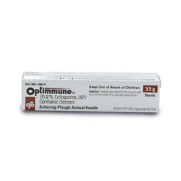
Topical Medications
Used mainly in dermatology (ear and skin) and ophthalmology
Meds are applied to the skin surface or mucous membranes in the form of an ointment, cream, gel, liniment, paste, lotion, powder, aerosol, or liquid drops.
Products are dissolved and then diffused into the skin
Slowest route of absorption
High concentration of drug locally,
may be absorbed systemically

Slide 7
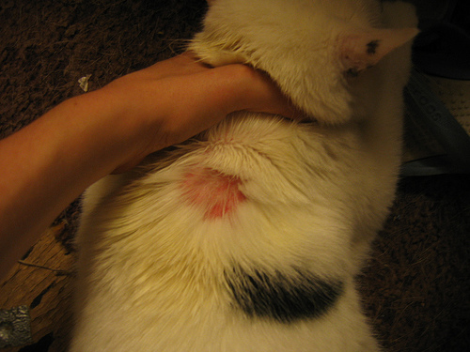
Topical Medications
May be irritating, animal may chew/lick it off
Easy to administer
Can use drugs that otherwise would be toxic if injected
Have to shave fur for good contact
Other topical routes: nasal, rectal, vaginal

Slide 8
FORMS OF TOPICALS
Drug suspended in….
Aerosols – packaged under pressure
Cream – water-oil emulsion
Gel – semisolid or jelly-like substance
Liniments – oily, soapy, or alcohol-based substance. Applied with friction
Lotions – liquid for dabbing, brushing, or dripping on skin without friction
Ointment – semisold, greasy preparation that melts at body temp
Paste – semisold that retains its state at body temp
Powder – powder for external lubrication or absorption

Slide 9
Oral Medications
Meds are delivered directly to the GI tract
Most convenient (owner can do)
Long duration of activity, slow onset of action
Relatively safe
No need for sterility
Gastric acid and disease may affect absorption
Ruminants have questionable absorption
Must get through GI mucosa

Slide 10

The Absorption of Oral Meds
The drug must be released from its form (tablet, capsule, liquid, powder, etc.) after the animal swallows it.
Tablets disintegrate in stomach liquid. Some tablets have an enteric coating, meaning the drug does not dissolve until it reaches the intestine. They cause less stomach irritation.
Molded tablets are soft, chewable and mixed with lactose, sucrose, or dextrose and frequently a flavoring
Capsules have a gelatin shell that holds in the powdered or liquid medication.

Slide 11
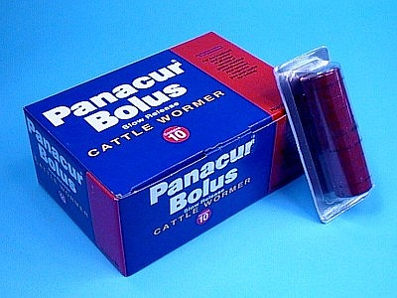
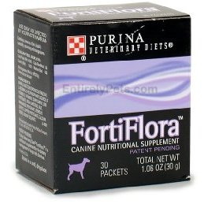
Oral Meds
  The shells dissolve in stomach liquids
Boluses are large rectangular tablets used in large animals.
Lozenges are in a hard, slow-release form. Not practical in animals (they will chew it)
Powders are dry and granulated and mixed with inert bulking and flavoring agents for dilution. These are easily mixed with food.

Slide 12
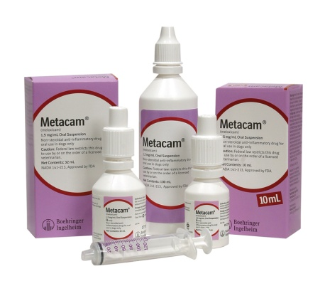
Liquids
SOLUTIONS- drug is dissolved in liquid. Will not settle out (syrups, elixirs)
SUSPENSIONS- finely divided undissolved liquid dispersed in water (shake the container to distribute)
EMULSION – fine droplets of oil in water or vice versa. Must shake vigorously
All 3 can be mixed with food. Liquids don’t irritate the stomach as much as solid meds because they don’t settle out in a focal spot.

Slide 13
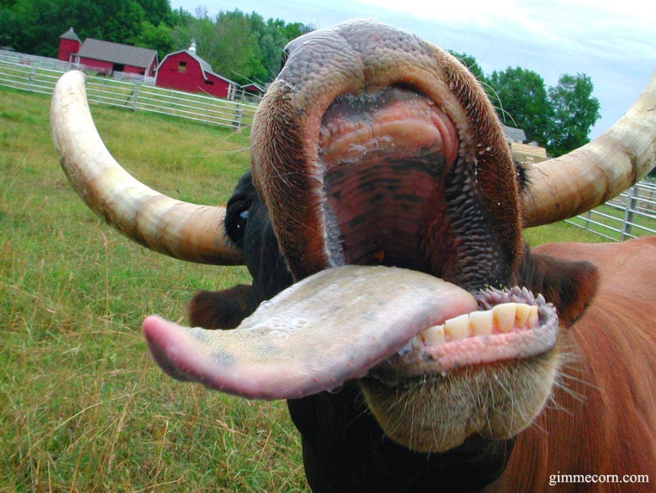
Say ahhh!
Anatomy can affect drug absorption. Some medications do not work well on ruminants because the more complex the digestive tract, the longer it
takes to achieve
therapeutic drug
levels. Drugs
given with food can
stay in the rumen for
3 days.

Slide 14
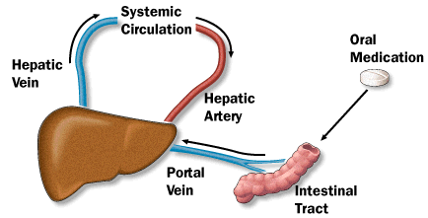
After the drug is absorbed by the GI tract, it must pass through the liver. The liver affects blood levels because it can alter a drug. BE CAREFUL with drug choices when the liver is not functioning properly.

Slide 15
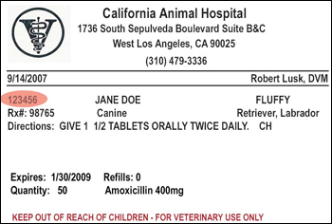
DOSING
DOSE = the amount of drug administered at one time to achieve the desired effect.
mL, cc, mg, Tablets

Slide 16
  LOADING DOSE – the initial dose of a drug given to achieve drug levels in the therapeutic range in a short period of time
  MAINTENANCE DOSE – dose that maintains the drug in the therapeutic range
  TOTAL DAILY DOSE – amount of drug given in 24 hours (ex: 1200 mg per day)
  DOSAGE – amount of drug per animal’s body weight (ex: 5 mg/kg, 1g/lb, 60 mEq/kg )
  DOSAGE INTERVAL – how frequently the dosage is given (SID, BID, TID, Q24H, Q12H, Q8H, Q6H, QD, Q2D, PRN, etc)
  DOSAGE REGIMEN – The combination of the dosage and dosage interval (ex: 5 mg/kg BID)

Slide 18
Your patient is reacting to the medication, now what?
Directly remove the drug
  Wash off the topicals, induce emesis for those ingested
Activated charcoal to bind what cannot be vomited
IV fluids to support the kidneys
Give an antidote if there is one
Provide care until the animal is through the toxicity

Slide 19
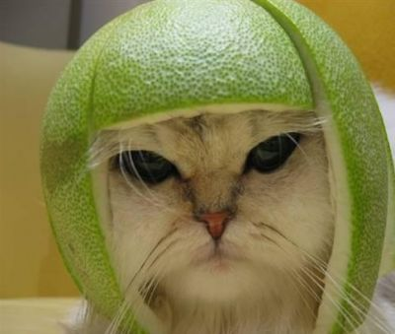
KEEP YOUR PATIENTS SAFE!

